Slide 1

Unit 6 It Changed My Life

Slide 2


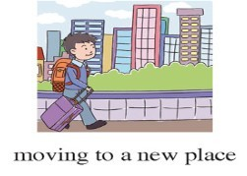

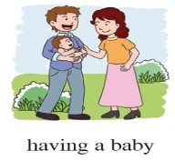

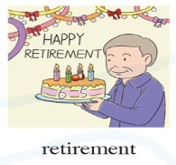


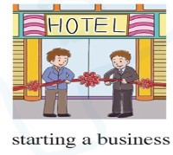
Among these life events, if you can only choose one thing, what will you do first?
找新的工作
创业
买新房
搬新家
结婚
生孩子
退休
毕业
升职

Slide 3

Review the following words:
突然
戒指
吻
招待会
发言
浪漫的
strike
disappointed
easy-going
tough
local
gradually
罢工
失望的
随和的
坚强的
当地的
逐渐地
suddenly
ring
kiss
reception
speech
romantic

Slide 4

Match the expressions
keep an eye on sb.
sooner or later
drink to sb./sth.
ups and downs
blow out
make a wish
come by
in honour of
go well with
be supposed to
照看；留意
迟早
为…而干杯
起伏
吹灭
许愿
获得；经过
为…纪念；庆祝；向…表敬意
与…相配；相处的好
应当
与…相配；相处的好
吹灭
应当
为…纪念；庆祝；向…表敬意
为…而干杯
起伏
迟早
许愿
获得；经过
照看；留意

Slide 5
Match the expressions
see…as
begin with
set up a family
apply for a new job
be sure to
turn out
no longer
a letter of invitation
show up
on one’s own
no longer
set up a family
show up
be sure to
see…as
on one’s own
turn out
begin with
a letter of invitation
apply for a new job
不再
建立家庭
出现；到场
一定要
把…看作是
独自
结果是
以…开始
邀请信
申请一份新工作

Slide 6

知识拓展：
B
People are ______ to ______ when they meet
for the first time.
A. suppose; shake hands
B. supposed; shake hands
C. supposed; shake hand
D. suppose; shake hand
2. I have no doubt _____ Tom is the tallest man in our team. （2008年单招高考）
A. if B. whether C. that D. what
be supposed to do
A/B
C

Slide 7
B
C
3. It is ten years since they ____.
(2006年单招高考)
A. have married B. have been married
C. got married D. have got married.
4. I was _____ when I heard the bad news.
A. disappointed B. disappointing
C. disappointment D. disappoint
They ____ for over fifty years.
C
She said she couldn't attend my birthday party, which was very ________.
Not getting the job was really a _______.
A
B

Slide 8
知识拓展：
A
5. She promise to _____ at the meeting but she didn’t _____.
A. turn up; keep her word
B. present; keep her promise
C. attend; turn up
D. appear; keep her words
6. We should not ____ our children all the time in real life.
A. keep on B. keep an eye on
C. keep an ear on D. get an eye on
be present at
B

Slide 9

Situational communication
Expressing Goodwill:
congratulations and goodwill.
祝愿 | Good luck! Enjoy yourself! Have fun! Congratulations. Well done!
应答 | Thank you. The same to you. You, too.
真题 --I’m taking my driving test tomorrow.
-- _____!
A. Cheers B. Good luck
C. Come on D. Congratulations
B

Slide 10
知识拓展
1.—It's your birthday today. Happy birthday to you!
—_________.
A. Thank you B. Excuse me
C. The same to you. D.OK
2. —I have passed the exam. —____________. A. That’s all right B. Congratulations C. You are lucky D. Gook luck to you
A
B

Slide 11

知识拓展
3.—John and I will celebrate our fortieth wedding anniversary(周年纪念日) next month. —oh, ____. A. cheer up B. well done C. go ahead D. congratulations
4. 如果你去参加英美人的婚礼，对新娘表示祝贺，你应该说： A. Congratulations! B. Best wishes. C. You are lucky. D. That's OK.
D
振奋起来
请便

Slide 12
Put the sentences into the right order.
①Look at that big tree over there.
② So do you feel happy now?
③ How time flies!
④ we are the happiest family in the world.
⑤ But you agreed to go out with me at last.
Mom：________________________. Dad：May and Danny have already grown up. Mom：I can still remember our first date. Dad： ________________________. Mom：Yeah, oh my god! It's still there. We have our first date right on there. Dad：Do you know that I fell in love with you at the first sight. Mom：You were dull at that time. Dad： ________________________. Mom：I can't believe this for it's been 20 years since we got married. Dad： ________________________. Mom：I couldn't have been any happier! Dad：Of course, ________________________.
知识拓展

Slide 13
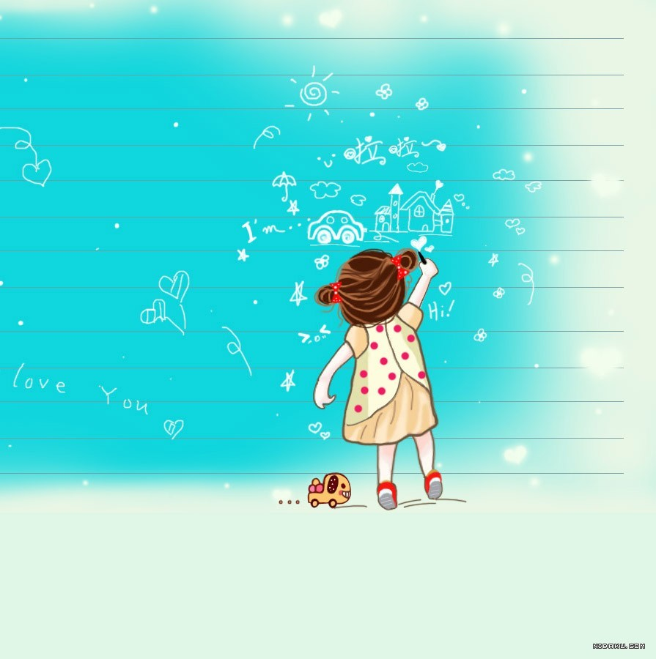
Homework:
1. Remember the knowledge of this unit.
2. Finish the paper of unit 1-6 Book V
3. Review unit 1-2 Book IV

Slide 14

Thank you!

