Slide 1

Unit 1
Where Has All My Money Gone?

Slide 2
warm-up
1. How much money do you spend every month?
2. Are you short of money all the time?
Do you often borrow money from your friends?
3. Have you made a finance plan for yourself?
4. Do you often find ways to save money?
5. Do you make a shopping list before going out
shopping in a store or a supermarket?
6. What’s the main topic of this unit?
7. What are we going to learn in this unit?

Slide 3
Listening
What’s the Matter? (P. 3)
Jenney: Hey, Billy. You look worried. What’s the matter?
Billy: Err. I need to buy a book, but I don’t have enough money.
Jenny: Why? Your mum has given you the money of this month,
hasn’t she?
Billy: Yes, she has. But I have spent it all.
Jenny: But it’s just been a week since she gave you the money.
How did you spend it?
Billy: Food, CDs, clothes, computer games….
I just don’t know where all the money has gone.
Jenny: Oh, I am sorry to hear that.
Billy: Look, Jenny, will you lend me some money?
Jenny: Ok. How much do you want?
Billy: I think ten pounds will do.
Jenny: Here it is. But I do suggest you make a monthly finance
plan for yourself. You spend money too easily.
Billy: I think you’re right. Thank you very much, Jenny.
Jenny: You are welcome.

Slide 4
Listening
Complete the following sentences (B: How to shop wisely)
1.Well, I’ll some tips in
stores or supermarkets. First of all, and
it.
2.Secondly, don’t bring too much money, Before
, how much money you
need your shopping list. To stop
yourself ,do not bring .
3.Next, don’t shop when you or
when you .In both situations, you
finishing shopping quickly on
thinking carefully. Don’t buy when .
4.Lastly and get out quickly.
The you spend in a store or a supermarket,
you .

Slide 5
Listening
Grammar
1. regret having done sth.= regret doing sth.
后悔做了某事
eg: I regret having told her the bad news.
= I regret telling her the bad news.
regret to do sth.
抱歉要做某事
I regret to tell you that you didn't pass your maths exam.
2. start with
从···开始，由···开始
eg: To make the lesson fun, let's start with an English song.

Slide 6
Listening
Grammar
3. avoid doing sth.
避免做某事
eg: The little boy stepped aside in order to avoid being knocked down by others.
4. figure out
计算出，解决
eg: Please figure out the total cost.
5. be based on
以···为依据
eg: The government decided to encourage industries based on biotechnology.

Slide 7
Speaking
Giving Tips
I’ll start with some tips on how to shop effectively.
The following are some tips on money management.
We may find these tools helpful when making a finance plan.

Slide 8
Speaking
Role-play
Situation 1
You’re Jenny in Conversation A. Your partner is Billy. You’re
giving Billy some tips on how to spend money wisely.
Situation 2
Your partner is always short of money. You’re giving him
or her some tips on how to make a money spending plan.

Slide 9
Reading
Passage A
How to Save Money?
节省,减少开支
Economize your social life. Package the leftovers for next day when you have dinner in a restaurant. When it's your turn to offer a meal, invite your friends to your home, cook the dinner yourself. If you are to attend a wedding ceremony and an expensive present is needed, ask several friends to go together to share a present. When separate from your boyfriend, send the gifts he sent you to your friends instead of throwing them away…

Slide 10
Reading
Passage A
How to Save Money?
Read quickly and answer
What’s the passage mainly about?
What are the tips on how to save money referred to in the passage?
What question will you ask yourself at the end of each month when you feel short of money?
What is the English saying in the passage?
How many parts is the text divided into?

Slide 11
Reading
Passage A
How to Save Money?
Three parts
Part 1. (Para. 1) Leading: You feel short of money and don’t
know where your money has gone.
Part 2. (Paras.2～4) Body: Some tips on saving money are given
in the part.
Part 3. (para.5) Conclusion: you should take action and carry out
your finance plan.

Slide 12
Reading
Passage A
How to Save Money?
True or false
1. At the end of each month, you still have much money with you.
2. It is not worth saving if you don’t have at least 1.000 yuan a month.
3. Save one or two yuan each day and you will have saved several hundred
yuan after a year.
4. Keeping a spending and savings diary can be a great way to motivate you to save more.
5. Having a very specific goal in mind can make it more difficult to save up.
6. With a detailed plan and decisive implementation, you’ll see the number in your bank account coming down instead of going up.

Slide 13
Reading
Passage A
How to Save Money?
Part 1. (Para. 1) Leading:
You feel short of money and don’t know where your money has gone.
you have a nice , but you still money.
each month, you often ask yourself,
“ ?” To help you better ,
here are .
salary
feel short of
At the end of
Where has all my money gone?
manage your money
some tips on saving money

Slide 14
Reading
Passage A
How to Save Money?
little and often | Do you tell yourself that if you don’t have 1.000 yuan a month? How about one or two yuan a day? It’s a that you barely notice .
Keep a and diary | Something for those who want to is to keep a spending and savings diary. Write down , so that you will have a clear picture of . the diary from time to time and you will see .
Save towards a . | in mind can make it easier . If you know that you need 3.000 for a new computer or if you . reach 5.000 yuan , . the end goal can .
Save
it’s not worth saving
at least
saving
tiny amount
on a daily basis
that’s often recommended
Spending
sort out their finances
savings
what you have spent
where…
Refer to
how your financial situation changes
Having a very clear goal
Specific goal
to save up
are determined to
in your emergency fund
focusing on
keep you motivated

Slide 15
Reading
Passage A
How to Save Money?
Part 3. (para.5) Conclusion: you should take action and carry out your finance plan.
Once you have your financial situation, and a
specific plan for saving money, the next most important thing is . Take action. With , you will see the number in your bank account .
figured out
have come up with
to implement the plan
a detailed plan and decisive implementation
going up instead of down

Slide 16
Reading
Passage A
How to Save Money?
Language Points
杭州值得一看。（worth)
这本书值得一读。（worth, worthy, worthwhile)
我几乎听不到他的声音。 (barely几乎不，几乎没有）
我们必须把好的苹果和坏的分开。（sort out 分类，区分出来）
It is worth paying a visit to Hangzhou.
The book is worth reading.
I can barely hear his voice.
We must sort out the good apples from the bad ones.

Slide 17
Reading
Passage B
Graduated from College Debt-free (勤工俭学上大学）
Read quickly and answer
1. What is the passage mainly about?
2. What are the three things Luke did to save money?
3. What did he prepare to do after Luke graduated?
4. What will you learn from Luke?

Slide 18
Reading
Passage B
Graduated from College Debt-free (勤工俭学上大学）
学案答疑
1.Some scientists predicted that humans would run out of our oil resources within 60 years.p.2 被动句：
2.I have no idea what the matter is.(改错）
3.All those in the crime last night will be questioned by the
police. (involve) p.3句子成分
4.What should we use for power when all the oil in the world has ?p.4
(give out, use up)
be used up；become exhausted用完；耗尽；力竭
Some scientists predicted that our oil resources humans would be run out of
within 60 years.
(who were) involved

Slide 19
Reading
Passage B
Graduated from College Debt-free (勤工俭学上大学）
5. be particular about讲究；对…挑剔p.17
Don‘t be too particular about others.不要对别人过于挑剔。
Being too particular about your shoes is not a good habit .
对你的鞋太挑剔是不好的习惯。
6. be nervous about 对 ... 感到紧张
I‘ll be nervous about speaking in your presence.
你在场在我讲话就紧张了。
7. ① Tom’s leg got hurt when climbing up Jindingshan.
② Tom’s leg got hurt when his climbing up Jindingshan.
(① climbing的逻辑主语② when后接现在分词）
Don’t talk while (when) eating.
Be careful when (while) crossing the road.

Slide 20
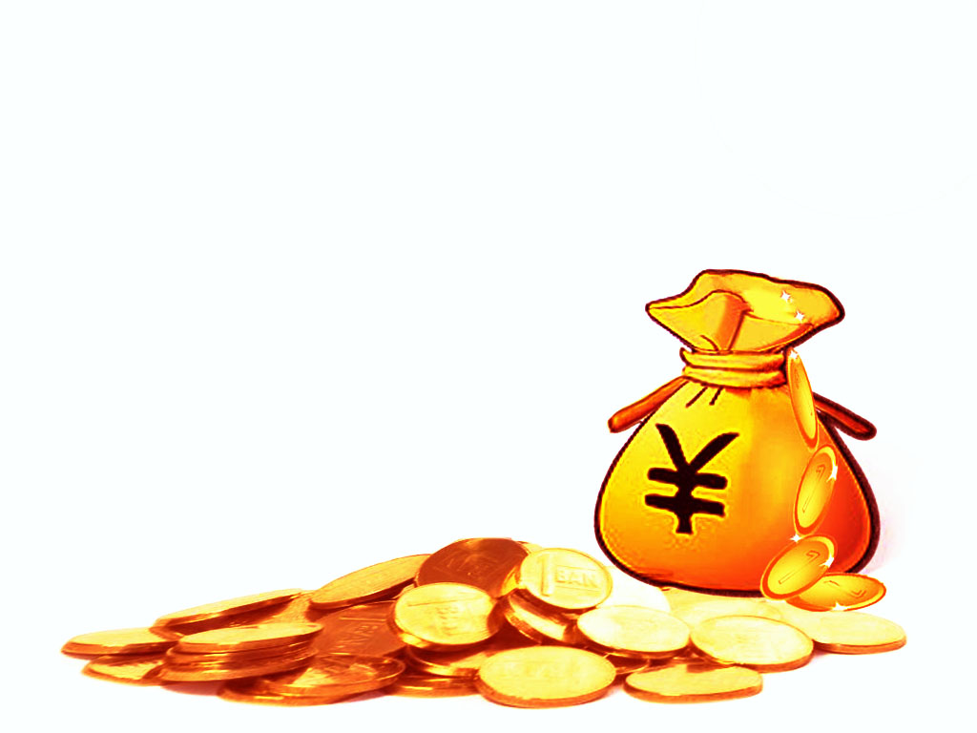
谢谢

